Slide 1
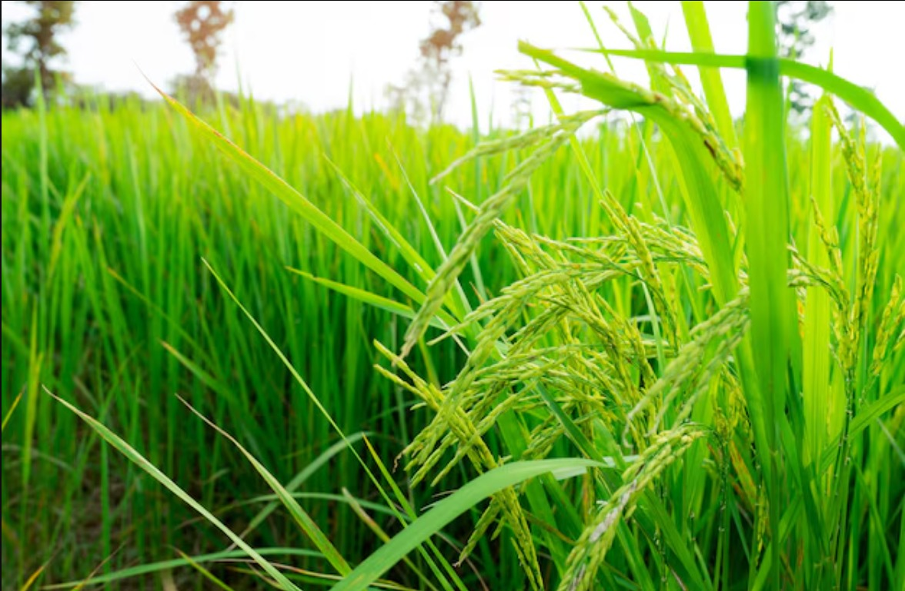

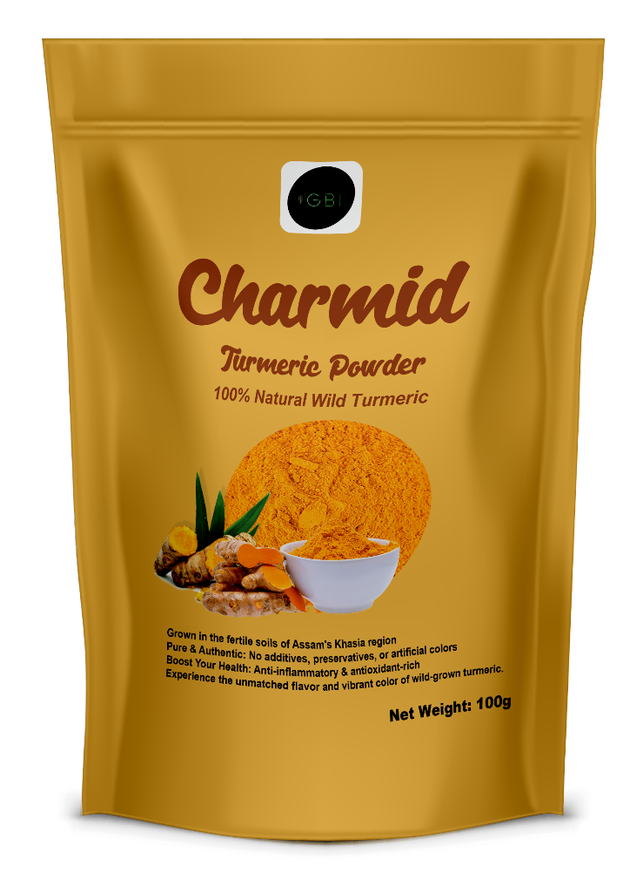

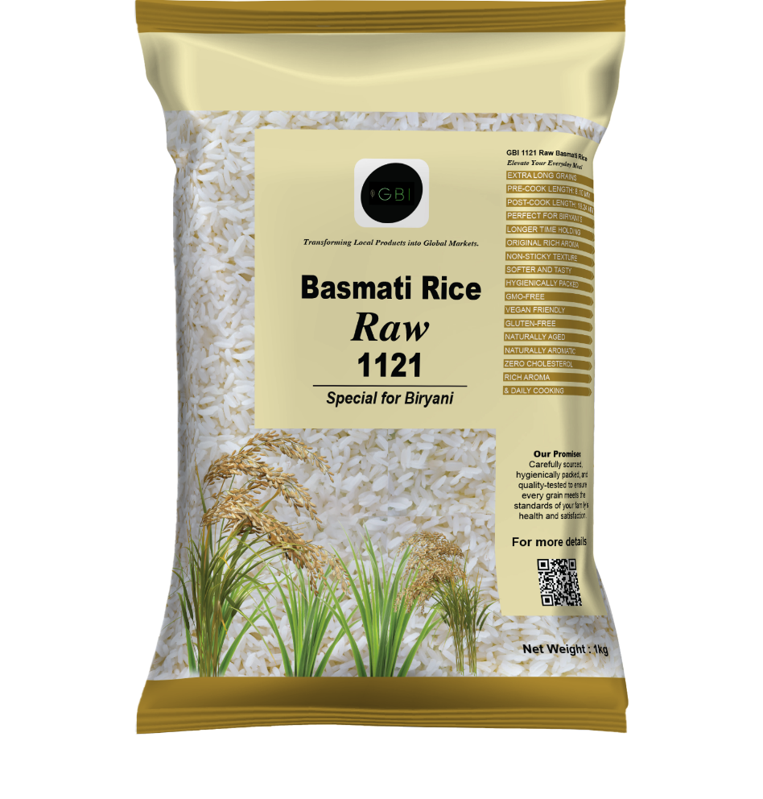
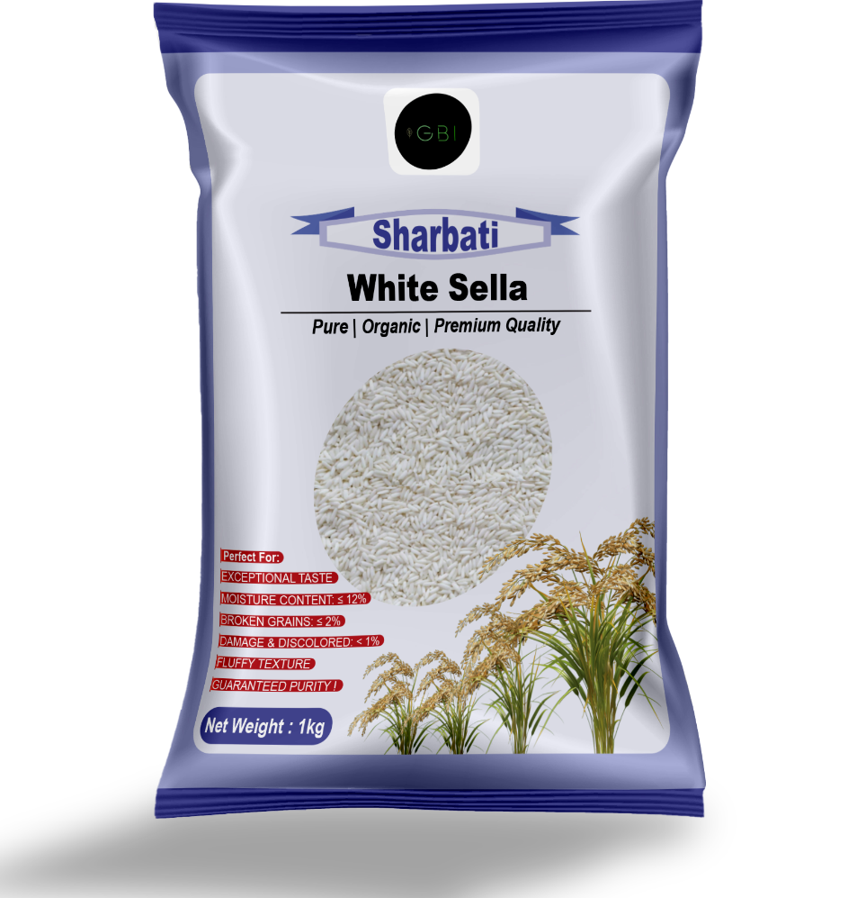
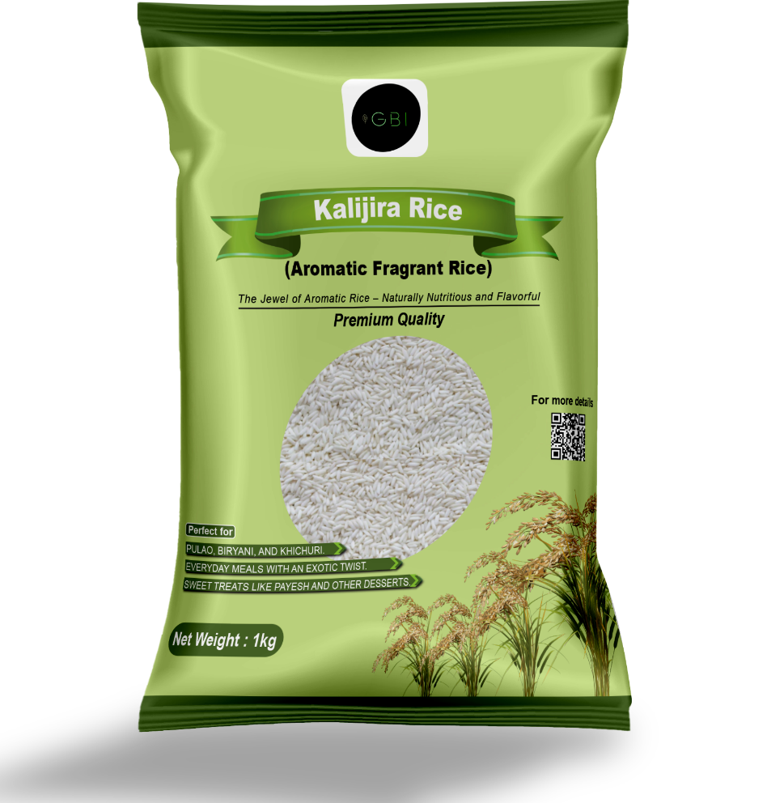
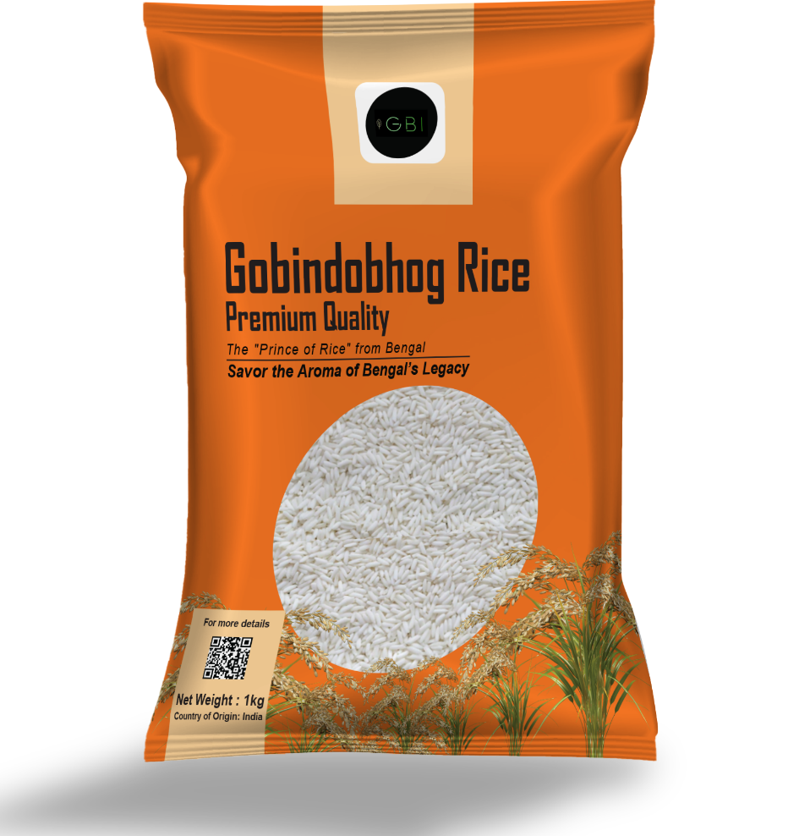
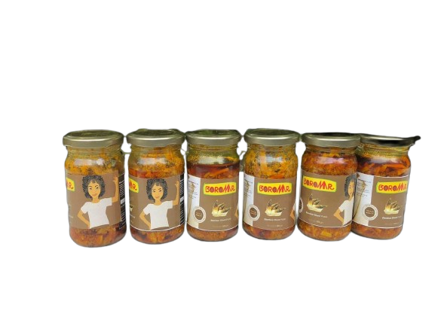
Green Business Initiative
Transforming Local Products into Global Markets
Notes:
https://unsplash.com/photos/PhYq704ffdA

Slide 2



Company's Overview
● Incorporation Date: 5th August 2023 (LLP)
● Incubated By: Assam Startup, Assam Government
Who We Are?
Core Business Activities:
Specializes in organic farming, organic products, and unique local products.
Engaged in the export of rice, spices, sugar, flour, and jaggery.
Focused on agriculture, agritech, and agri-tourism.
Dedicated to empowering small farmers by enhancing production, branding, and global distribution.
Following climate-resilient and organic farming methods.
Bridging the gap between local farmers and the global marketplace.
02

Slide 3
Mission, Vision & Core Values
Mission
1 | To promote sustainable and eco-friendly agricultural practices while providing high-quality food products to global markets.
2 | Ensuring economic empowerment for farmers through fair trade and direct partnerships.
3 | Expanding into emerging markets while strengthening trade relations with existing partners.
Vision
1 | Deliver high-quality, sustainably sourced rice and spices.
2 | Utilize modern technology for improved processing, packaging, and supply chain efficiency.
3 | Expanding into emerging markets while strengthening trade relations with existing partners.
4 | Promote fair trade practices, ensuring better profitability for farmers.
5 | To become a leading global supplier of premium Indian agricultural products.
6 | Revolutionizing the global rice and spice trade through sustainable farming, innovative processing, and efficient global distribution.
Core Values
1 | Sustainability | Championing eco-friendly and regenerative farming.
2 | Innovation & Excellence | Continuous improvement in production, branding, and processing.
3 | Fair Trade & Farmer Empowerment | Direct partnerships with farmers to ensure fair pricing.
4 | Integrity | Ethical business practices and transparency.
5 | Dependability & Accountability | Reliable supply chain and market commitment.
03

Slide 4
Problem Statement (Market Pain Points)
● Growing concern about environmental & economic sustainability.
● Limited access to organic and eco-friendly products.
● Challenges for traditional farmers and artisans in reaching the market.
● Lack of digital marketing and branding for local agricultural products.
● Need for stronger connectivity to integrate local resources into the mainstream economy.
● Impact of job insecurity on rural migration and economic stability.
Required logistics resources, for domestic supply and international purposes. Need for better infrastructure for our increasing market captures.
04

Slide 5
Why Climate-Resilient Cultivation?
1. Environmental Preservation is Critical for Future Generations Ensuring environmental sustainability is essential to protect natural resources and eco systems. The health of the Assam region depends on sustainable practices. Neglecting this can lead to irreversible damage and biodiversity loss.
2. Consumers are Increasingly Seeking Sustainable and Healthy Product Options Growing demand for eco-friendly and health-conscious products. Consumers prefer products with minimal environmental impact. Meeting market demand requires sustainable and eco-friendly solutions.
3. Supporting Local Artisans and Farmers Can Boost Rural Economies Empowering local artisans and farmers through improved market access. Better marketing strategies can generate economic benefits for rural communities. Support enhances livelihoods, preserves traditional crafts, and promotes sustainable agricultural practices.
4. Natural Resources and Products Lack Market Access Due to Connectivity Issues Many valuable natural resources and locally produced goods remain underutilized or undervalued. Poor market access and connectivity challenges hinder their integration into mainstream economic activities. Enhancing connectivity and resource integration can drive economic growth and ensure fair distribution of benefits.
05

Slide 6
Our Solution (GBI Approach)
Productions & Marketing:
Organic Agro-products
Productions : Local unique spices, such as Tezpata, Dry hatkora, Aromatic rice, diabetic friendly rice, kajira rice sticky rice, Gobindobhog rice, different regional rice varieties, and spices from major Indian agricultural regions.
Quality Assurance: 100% natural, non-GMO, free from harmful fertilizers/chemicals. ○ Branding & Packaging: Modern branding and eco-friendly packaging for global appeal.
Global Market Expansion
Including Basmati rice, non-Basmati varieties, and more different spices, sugar, jaggery from major Indian agricultural regions
Connecting small- scale farmers and artisans to international buyers.
Sustainability & Climate-Resilient Farming
Adoption of regenerative multi- crop farming techniques.
Education and training for 1,0000+ small farmers on eco- friendly practices.
Promoting climate - Resilient methods to combat environmental degradation.
06

Slide 7
Stakeholder Involvement & Social Impact
Environmentally Conscious Consumers
Demand for organic, eco-friendly, and sustainable products is increasing.
GBI ensures natural, nutritious, and premium agro-products.
Local Farmers & Artisans
Addressing market access, branding, and fair pricing issues.
Skill development & training programs for climate-resilient farming.
Global Markets Looking for Sustainable Products
Middle East & Africa markets are shifting towards organic & premium food products.
GBI aims to be a trusted supplier of sustainable agro-products.
Economic Development in Rural Communities
Job creation for farmers & workers in agro-processing units.
Reducing migration issues through sustainable employment opportunities.
07

Slide 8
Product Categories & Market Positioning
Core Product Categories
Rice Market Strategy
Spices & Agro-Products Expansion
Sugar, Flour, & Jaggery Expansion
Types: Basmati, Non-Basmati, Sticky, and Aromatic Rice.
Sourcing Locations: Punjab, Haryana, UP, West Bengal, Assam, Tamil Nadu.
Target Markets: Middle East, Africa, Europe, South Asia
Sourcing Strategy: Partnered with farmers & mills, manufacturing units in different Indian regions to ensure high-quality production.
Marketing Strategy : B2B wholesale and packaged consumer goods for supermarkets.
Top Spices: Cardamom, Black Pepper, Cumin, Turmeric, Cloves, cinnamon, cssia, Nutmeg, etc.
Sourcing Regions: Kerala, Gujarat, Tamil Nadu, Maharashtra, Kolkata.
Distribution Strategy: B2B wholesale and packaged consumer goods for supermarkets.
Products: Organic cane sugar, refined sugar, whole wheat flour, multi-grain flour, traditional jaggery blocks & powder.
Sourcing Locations: Maharashtra, UP, Karnataka.
Market Strategy: Bulk supply for food processing industries.
08

Slide 9
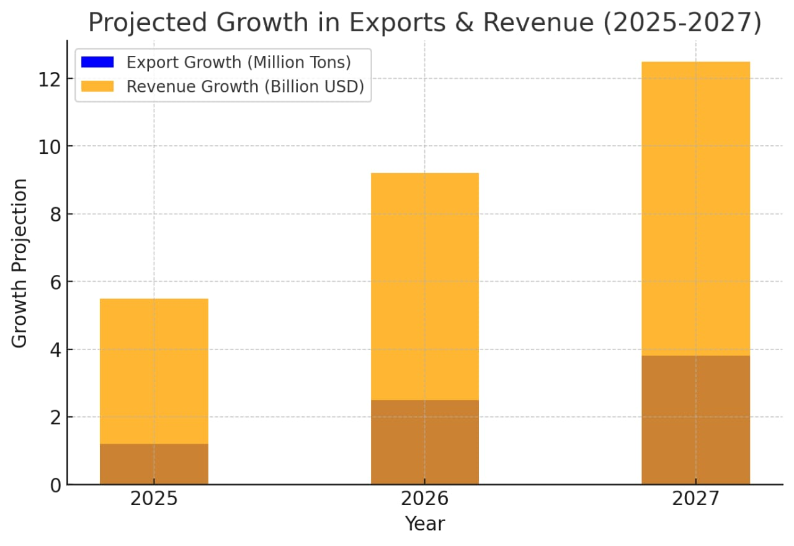
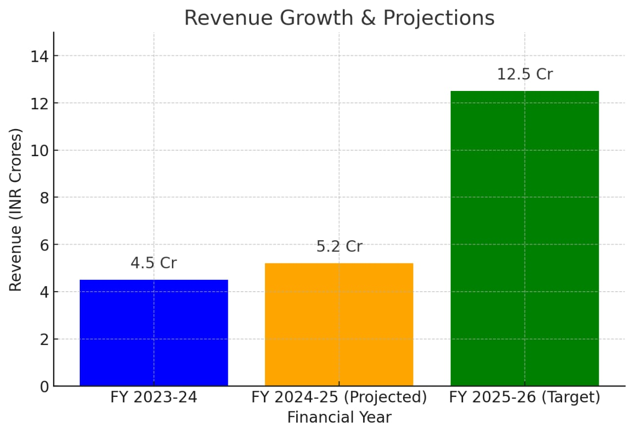
GBI Historical Projections.
Growth Projections (2023-2027)
Year | revenue
Historical & Projected Revenues
FY 2023-24 | $5,400
FY 2024-25 (Projected) | $6,200
5-Year Growth Projection
Year 1 | $300,000
Year 2 | $660,000
Year 3-5: Expansion into new global markets &
additional product categories
Market Size & Growth Trends
Total Addressable Market(TAM): USD 3.84 Billion
CAGR (Compound Annual Growth Rate): 3%
Expected Market Capture by 2027:
Global: USD 2.41 million in Aromatic Rice
India: USD 0.45 million in Aromatic Rice
09

Slide 10
Milestones for FY 2025-26
Milestones for the Next 1 Year
Milestone | Action Point | 1st Quarter | 2nd Quarter | 3rd Quarter | 4th Quarter
Expanding Farming Area | Increase from 9 acres to 90 acres | Expand to 15 acres | Expand to 20 acres | Expand to 25 acres | Expand to 30 acres
Increasing Farmer Partnerships | Grow from 40 to 110 farmers | Add 10 farmers | Add 15 farmers | Add 20 farmers | Add 25 farmers
Installing Automated Packaging Machines | Improve efficiency with modern packaging solutions | Install machines | - | - | -
Expanding International Trade & Logistics | Marketing, trade fairs, and distribution networks | Ongoing | Ongoing | Ongoing | Ongoing
Achieving Revenue Target | Target ₹12.5 Crores (~$1.5M) for FY 2025-26 | Revenue growth | Revenue growth | Revenue growth | Revenue growth
10

Slide 11
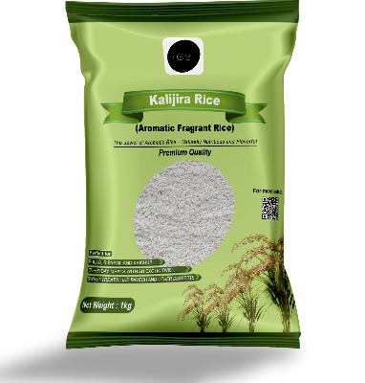


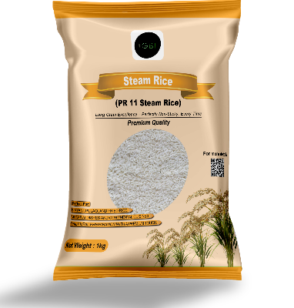
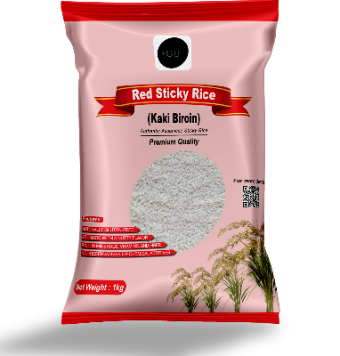
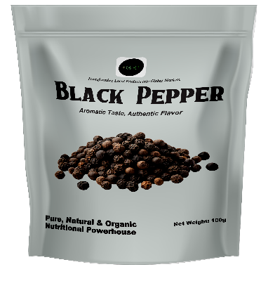
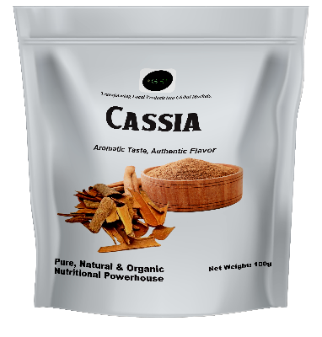
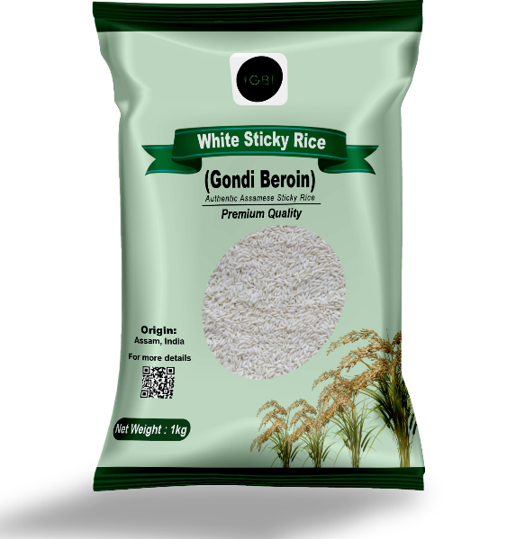
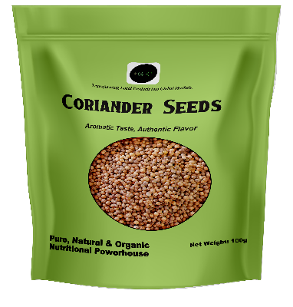
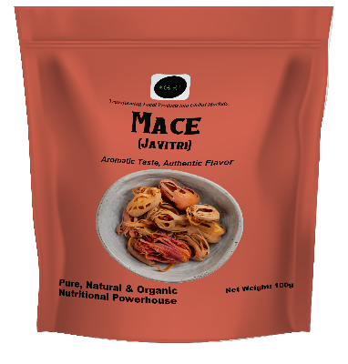

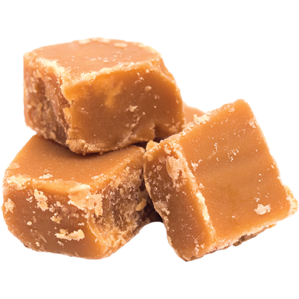




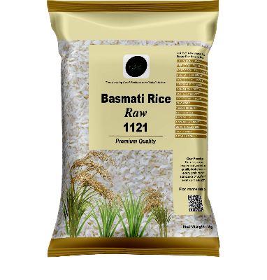
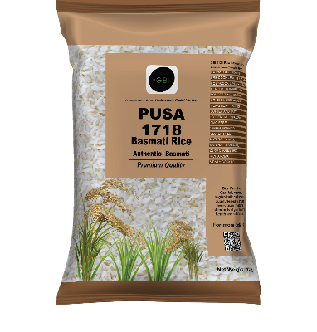
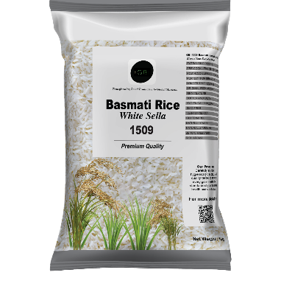
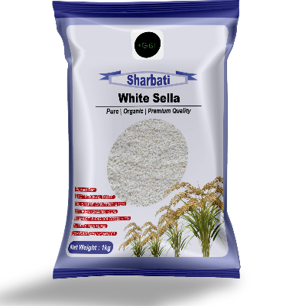
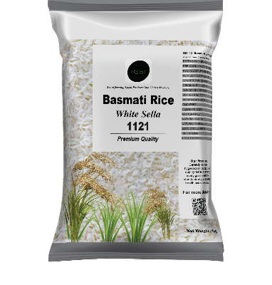
GBI Product Portfolio
Organic Product
Sugar & Jaggery
Spices
Non-Basmati Rice
Basmati Rice
Pickle
11

Slide 12
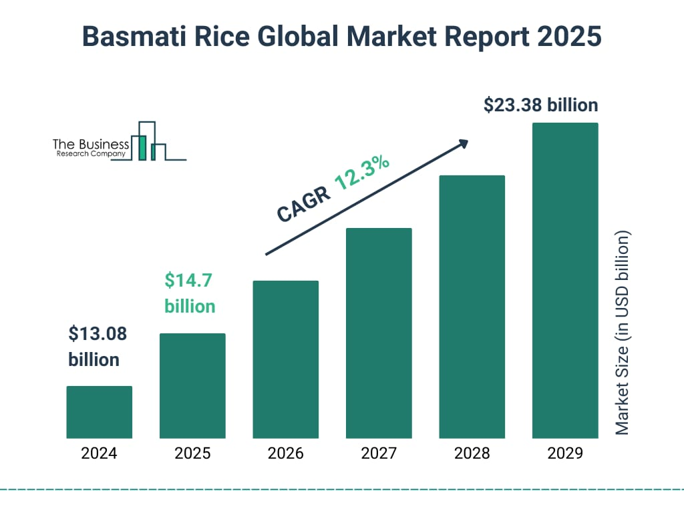
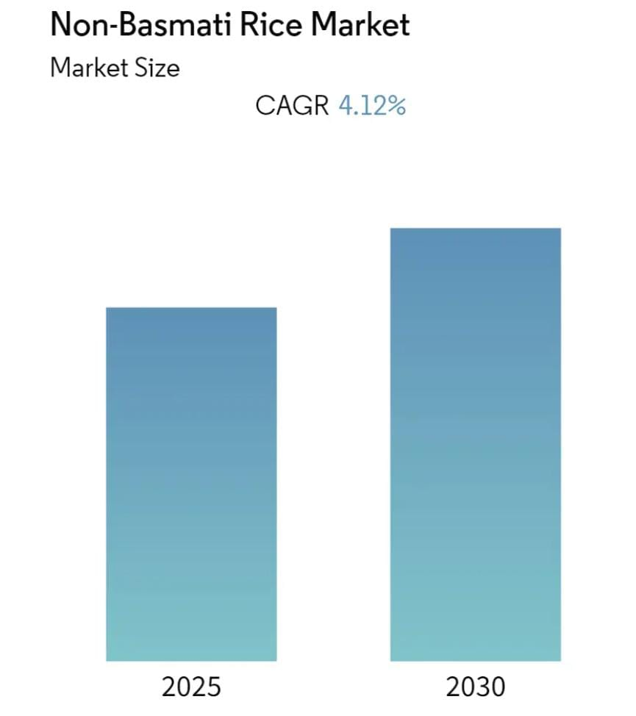
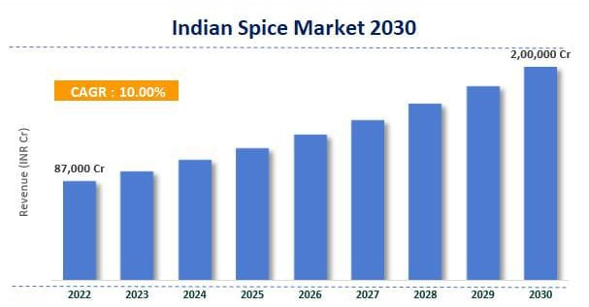
Indian Agricultural Market Trends
Overview of Rice, Spices, Sugar, Flour, and Jaggery Industries
Rice Market Trends
India's rice market is projected to generate approximately $112.08 billion in revenue by 2025, with a CAGR of 6.75% (2025-2030).
India accounts for 40% of global rice exports.
Basmati rice is highly valued in the Middle East, Europe, and the USA.
Forecast Data Period: 2025-2030 | CAGR: 4.12% | Fastest Growing Market: Asia-Pacific | Largest Market: Asia-Pacific | Market Concentration: High
Spices Market Trends
The Indian spices market is projected to reach approximately $61 billion by 2033, growing at a compound annual growth rate (CAGR) of 10.00%.
Growing demand for packaged spices—22% of consumers prefer branded spices over loose ones.
India contributes over 70% of global spice production.
12

Slide 13
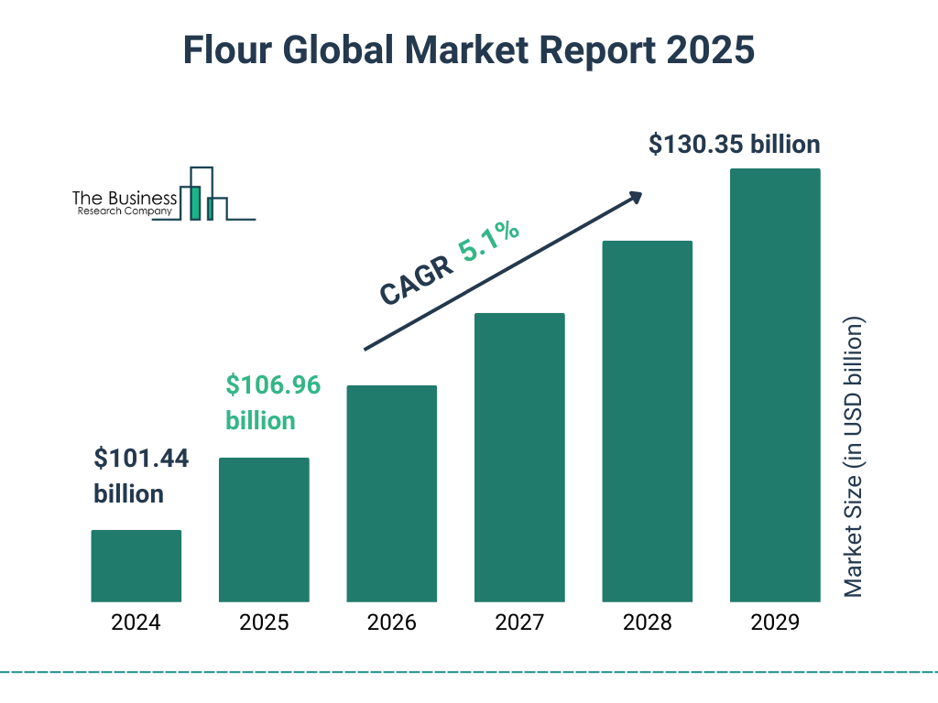
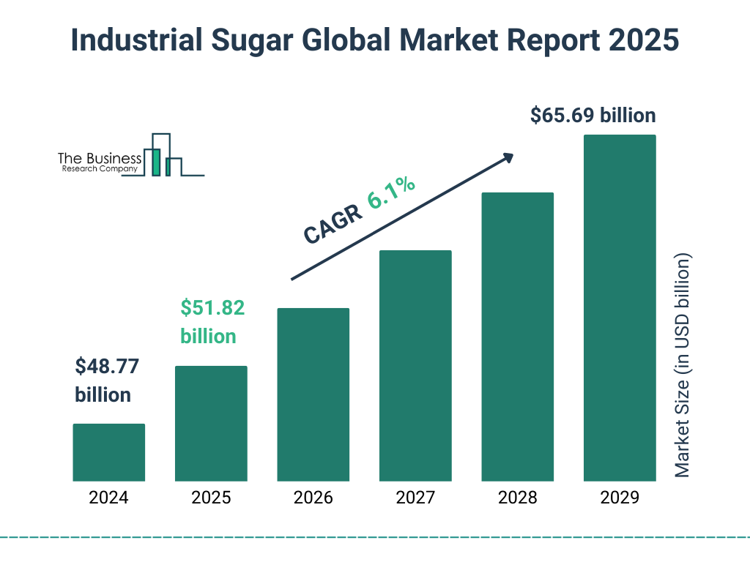
Indian Agricultural Market Trends
Overview of Rice, Spices, Sugar, Flour, and Jaggery Industries
Sugar, Flour, and Jaggery Industry
Sugar: India’s total sugar export quota for 2025 is 1 million tons; expected to grow due to increased demand.
Flour: Global wheat exports (2024/25 projection) are 214.9 million tons, with India capturing a share in the organic flour segment.
Jaggery: Rising demand for organic jaggery products in the Middle East and Africa.
Sourcing & Production Hubs
Rice: Punjab, Haryana, West Bengal, Uttar Pradesh, Assam.
Spices: Kerala, Gujarat, Tamil Nadu, Maharashtra, Karnataka.
Sugar & Flour: Maharashtra, Uttar Pradesh, Karnataka.
13

Slide 14
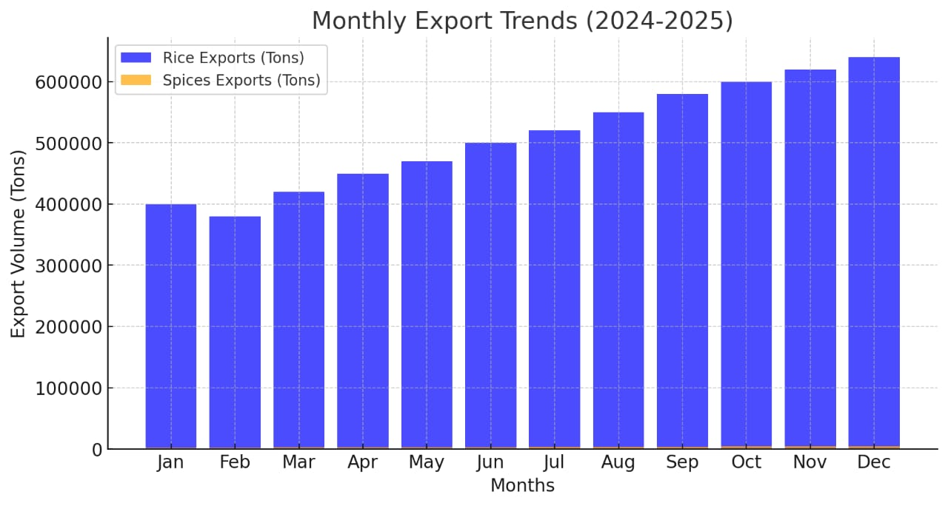
Global Trade & Export Trends
Indian Export Data & Market Expansion
● Rice Exports:
India’s total rice export revenue surpassed $11 billion in 2024.
Key export destinations: Middle East, Africa, Europe, USA, Canada, UK.
● Spices Exports:
India’s total spice exports (2024): 1.4 million tons.
● Sugar Exports:
India’s total sugar exports (2025): 1 million tons, and it will increase by December, 2025. Market Demand
Middle East & Africa: Increasing demand for premium-priced Basmati rice and spices.
Europe & USA: Growing preference for organic and high-quality agro-products.
14

Slide 15
Competitive Landscape
Market Challenges & Opportunities
Major Competitors:
Rice: India competes with Thailand, Vietnam, Pakistan in global markets.
Spices: Key players include MDH, Everest, Patanjali, Zoff, Catch.
Challenges in Global Export Market:
Government regulation fluctuations impact supply chain stability.
Logistics & Cold Storage Needs:
Investments in refrigerated transportation & cold storage are crucial for spice exports.
Price Sensitivity:
Export pricing fluctuations affect profit margins & demand.
15

Slide 16
GBI Market Expansion & Global Reach
International Market Penetration Strategy
1. | Initial Focus Regions | Middle East, Africa, Europe, South Asia
2. | Pre-orders Received From | Dubai, Madagascar, Sweden, Mauritius
3. | Upcoming Plan Expansion Into | Qatar, Oman, Saudi Arabia, UK, Canada, USA
Expansion into Other Agro-Products
Product Diversification Strategy
Sourcing & Production Regions
Feasibility & Market Research
Sugar: Organic cane sugar, refined sugar
Flour: Whole wheat, multi-grain flour
Jaggery: Traditional jaggery blocks and powdered jaggery
Sugar Mills: Maharashtra, Uttar Pradesh, Karnataka
Flour & Jaggery Processing Units: Partnering with processing units in top production regions
Conducting feasibility studies for regional preferences and compliance.
Establishing partnerships with food distributors, wholesalers, and supermarkets.
Exploring B2B and retail private-label opportunities in global markets.
16

Slide 17




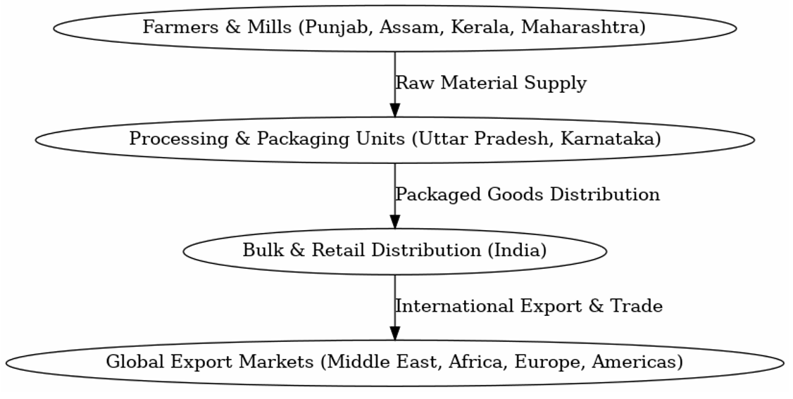
Distribution & Logistics Strategy
Overview of Supply Chain & Export Compliance
● Bulk Exports: Partnering with local startups, agro-based companies, suppliers, distributors & wholesale buyers.
● Retail Expansion: Supermarkets (Carrefour, Lulu, Al Meera).
● E-commerce & Quick Commerce Partnerships: Amazon UAE, Flipkart, Noon, Talabat.
Retail Expansion
Establishing offline retail presence for premium rice and spices. Offering private labelling for global retailers.
Export Compliance & Certifications:
FSSAI, ISO, HACCP, Halal, FDA Certifications for global trade.
Aligning with Middle East , European, and international food safety regulations.
Brand Positioning as "Pure & Organic”
✔ Retail chain partnerships for global visibility
17

Slide 18
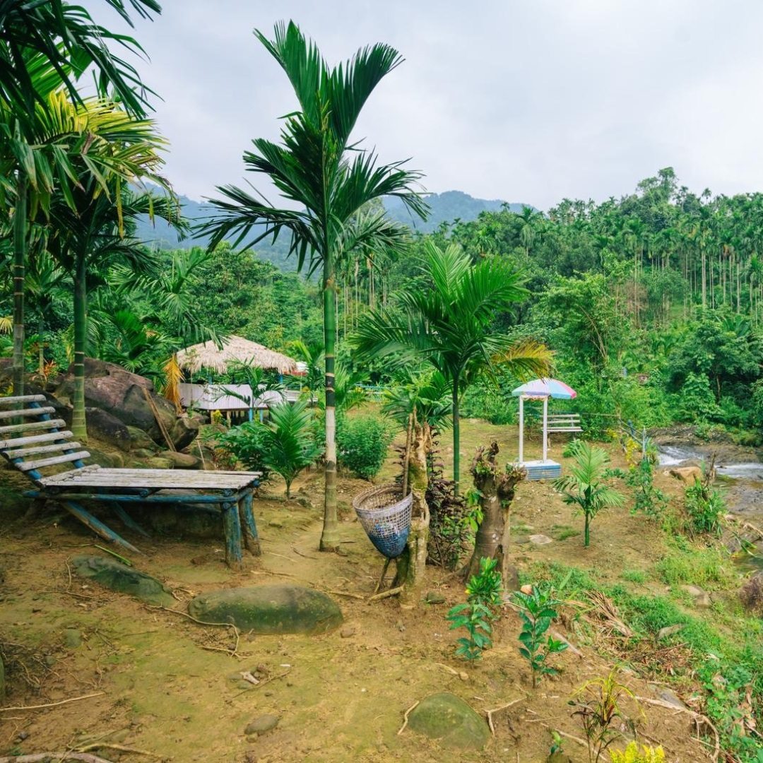

Strategic Expansion &
Infrastructure Development
Scaling Production & Market Reach
● Expanding farmland for organic & climate-resilient farming.
● Enhancing partnerships with food processing units & mills.
● Increasing automated packaging for efficiency.
● Strengthening logistics & warehousing infrastructure.
Future Roadmap & Investment
● Developing cold storage & warehouse facilities.
● Partnering with logistics firms for efficient global exports.
● Establishing an Eco-Park for agri-tourism & sustainable farming education.
18

Slide 19
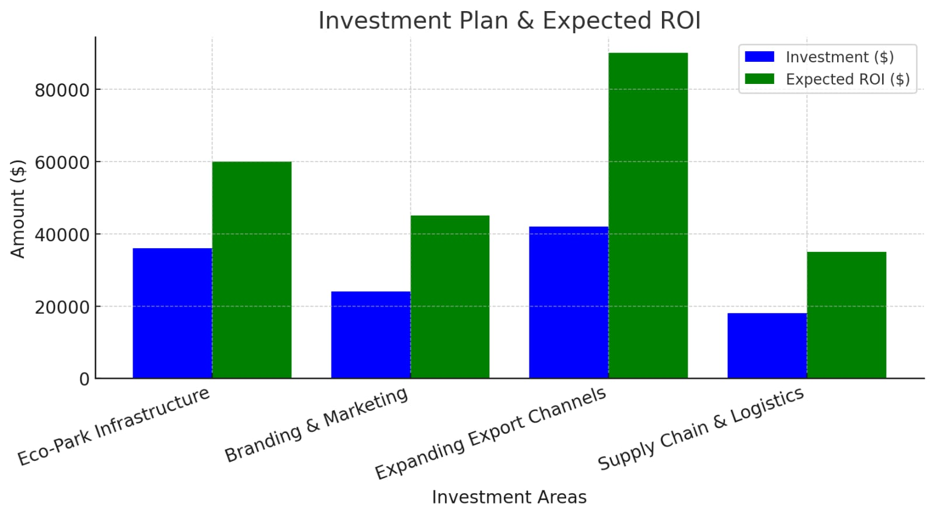
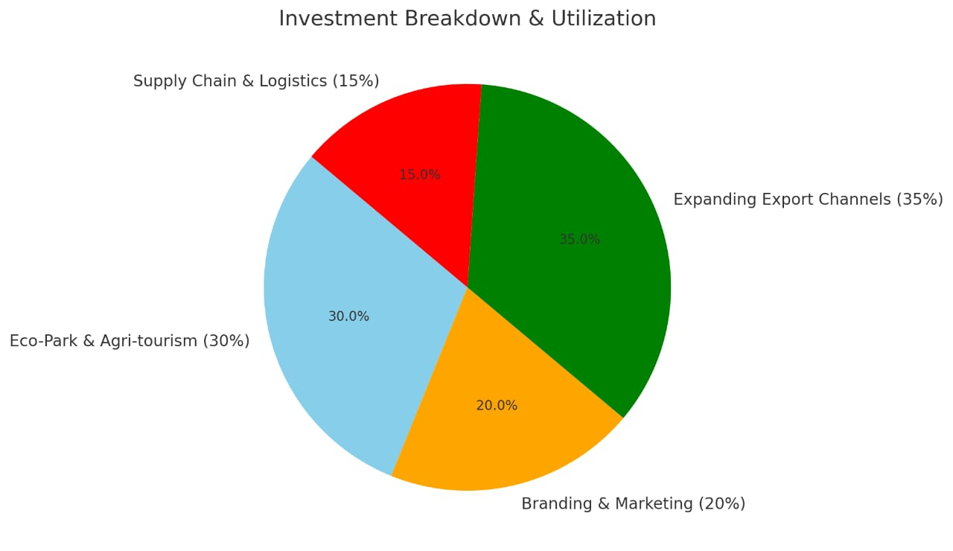
Investment Plan & Funding Requirements
Investment Breakdown
Expected ROI & Profitability Projection
Opportunities For Growth
● $36,000 for Eco-Park infrastructure & Agri-tourism
● $24,000 for Branding, Marketing, and Packaging
● $42,000 for Expanding Export Channels
● $18,000 for Supply Chain & Logistics
● Projected 20% Annual Growth in Revenue
● Break-even expected in 2 years
● High profitability projected in 5 years
● Expanding into high-demand markets for premium agro-products
● High-growth sector with increasing global demand for organic agro-products.
● Scalable business model with B2B & B2C opportunities.
● Partnership opportunities in Europe, Gulf, and Africa.
● Projected CAGR above 18%.
19

Slide 20
GBI Projected Market Capture (2025-2027)
Global Market ( 2025 – 2027 )
Indian Market ( 2025 – 2027 )
● Total Expected Market Capture: USD 2.41 million in Aromatic Rice
● Key Export Destinations: Africa, Mauritius, Sweden, Dubai, and other international markets
● Total Expected Market Capture: USD 0.45 million in Aromatic Rice
● Strategic Growth Plan: Gradual supply expansion to enhance brand presence and market penetration
Rice Market Expansion
Market Capture Targets:
Basmati Rice
India’s Total Production (2025): 8.96 million tons
Our Targeted Share: 0.18% of India’s Basmati Rice production
Global Market Revenue Share: 0.18%
Non-Basmati Rice
India’s Total Non-Basmati Rice Exports (2024): 7.4 million tons
Our Targeted Share of India’s Exports: 0.14%
Pre-orders secured from multiple global markets
Projected Global Exports:
Basmati Rice: 16,000 tons
Non-Basmati Rice: 10,000 tons
Sticky & Aromatic Rice: 50 tons
20

Slide 21
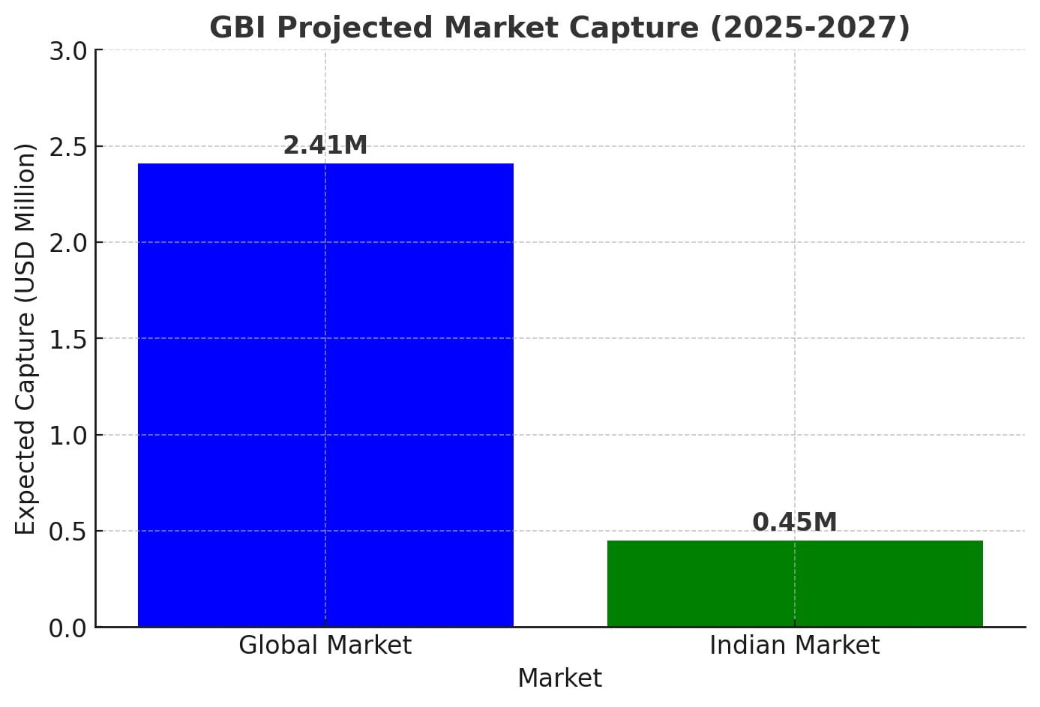
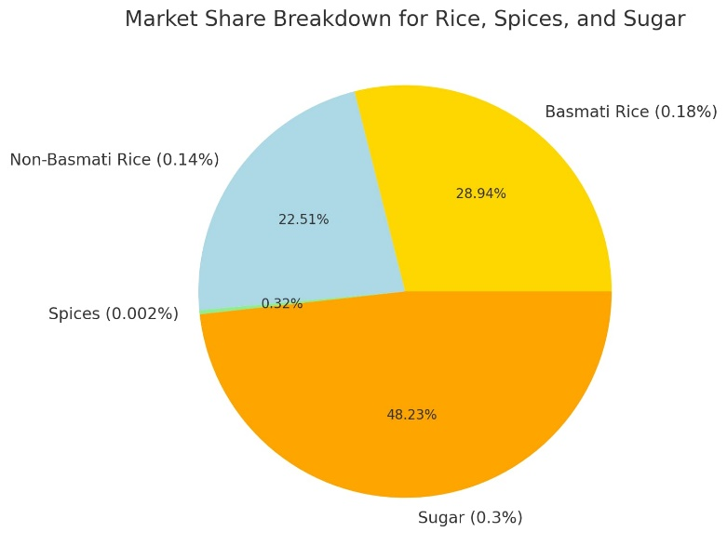
Spices Market Expansion
● Indian Market Supply: 10-15 tons (Strategic domestic supply for brand growth)
● Market Capture Target:
India’s Total Spice Exports (2024): 1.4 million tons
Our Targeted Share: 0.002%
Sugar Market Expansion
● Market Capture Targets:
India’s Total Sugar Export Quota (2025): 1 million tons
Our Targeted Share of India’s Exports: 0.3%
Global Sugar Market Exports (2024-2025): 214.9 million tons
Our Targeted Share of Global Market: 0.004%
Flour Market Expansion
● Market Capture Target:
Global Wheat Exports (2024/25 Projection): 214.9 million tons
Our Expected Share in Global Wheat Market: 0.67%
21

Slide 22
Strategic Vision &
Growth Objectives (2025-2027)
● Strengthening global presence in Aromatic Rice, basmati and non basmati varieties.
● Organic Agro-Products, and essential commodities
● Adding sugar, flour, jaggery, and grains in product Categories, and enhancing the amount of export.
● Expanding exports to new international markets to enhance revenue and brand visibility
● Building strong domestic brand recognition in India through gradual supply expansion
● Establishing GBI as a key player in sustainable agro-based exports
22

Slide 23
Future Outlook & Investor Benefits
Why Invest in the Spices & Rice Markets?
Sustained Market Growth:
● Spices CAGR: 5.69% (2024-2025).
● Rice CAGR: 3.1% (2024-2025).
High Profitability:
● Profit margins increased in both industries, reaching 19% for spices and 10.5% for rice in 2025.
Export Potential:
● Global spice exports are expected to cross $4.5 million tons by 2025.
● Global rice exports are expected to exceed 51 million tons by 2025.
Diverse Investment Options:
● Opportunities in equity, venture capital, government grants, and IPOs.
Conclusion
The global spices and rice markets offer strong investment opportunities with stable revenue growth, increasing profit margins, and expanding global demand. With an expected market value of $25.89 billion for spices and $333.73 billion for rice by 2025, these industries provide high returns on investment and long-term sustainability
23

Slide 24
Why invest in GBI?
High-Growth Organic Agro-Export Market.
Strong Supply Chain & Eco-Friendly Practices.
Proven Revenue Growth & International Orders.
Strategic Expansion into Gulf, Europe, Africa.
GBI Competitive Advantage
● Direct Farm-to-Table Model: Cutting out middlemen, benefiting both farmers & consumers.
● 100% Organic & Eco-friendly Farming: No GMO, no chemical fertilizers.
● Sustainable Practices: Regenerative farming, low-carbon footprint supply chain.
● Growing Global Market Demand: High demand for premium Indian agricultural products.
● Strategic Global Expansion: Pre-orders already received from Dubai, Madagascar, Europe, and the Middle East.
● Quality Assurance: Modern processing and packaging meeting international food safety standards.
Sustainable & Good Agricultural Practices (GAP
✔ 100% Non-GMO & Chemical-Free Farming
✔ Water Conservation & Regenerative Farming
✔ Fair Trade & Worker Welfare Programs
24

Slide 25




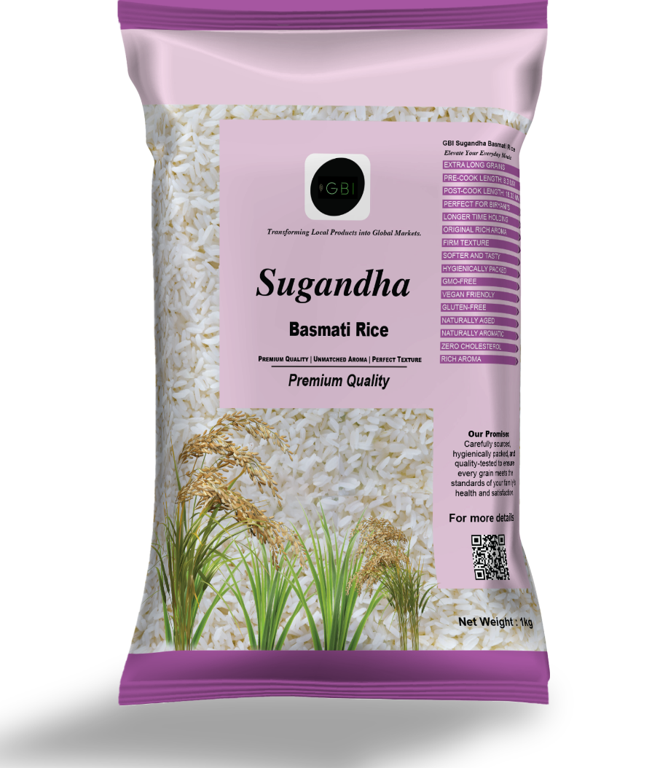
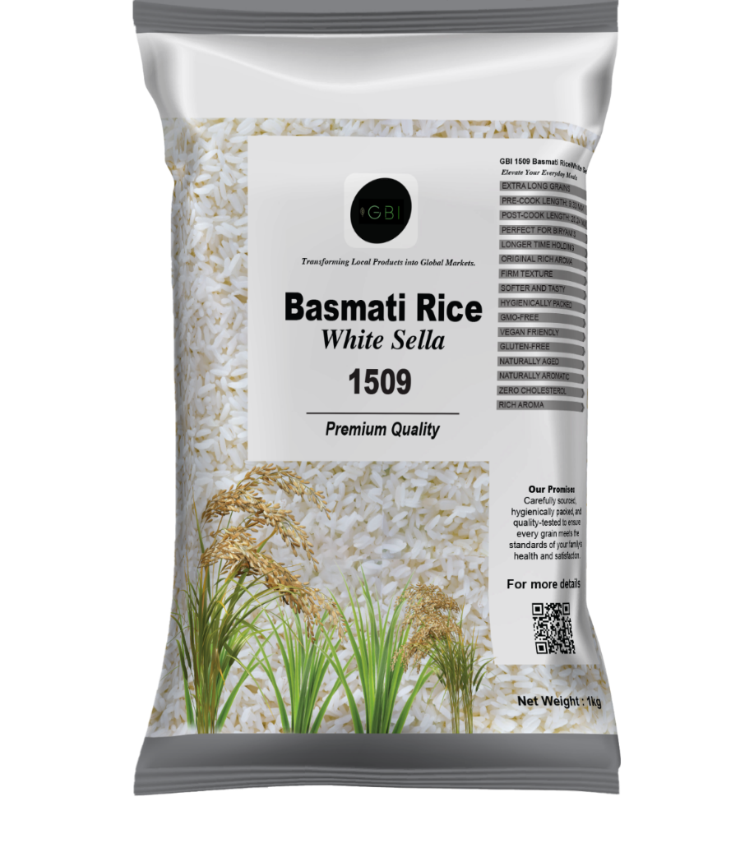




Call to Action – Let’s Grow Together!
● Join Us in Transforming Indian Agro-Exports
● Connect with GBI for Collaboration & Investment
Email: info@gbillp.com
Phone: +1 347659-3457
Website: www.gbillp.com
Location: HEAD OFFICE (India) Paikan Katigorah, Kalain, Gumrah Grant, Cachar, Assam-788815, INDIA
● Follow Us on Social Media for Updates on export data and market trends.
25

Slide 26
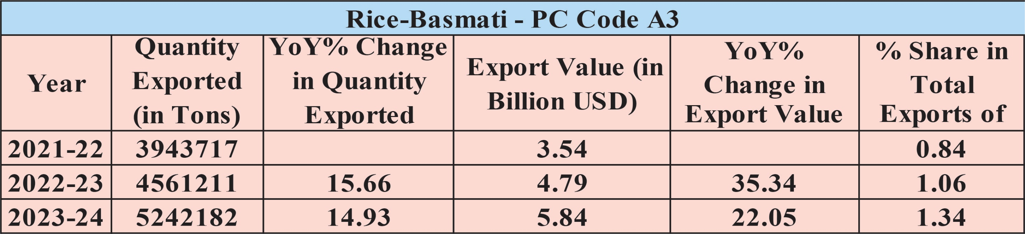
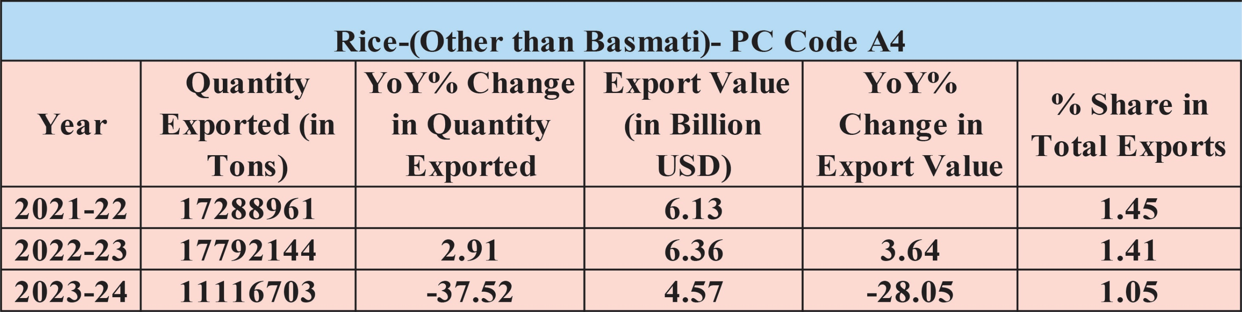
Export Trends Indian Basmati & Non-Bsmati Rice
26

Slide 27
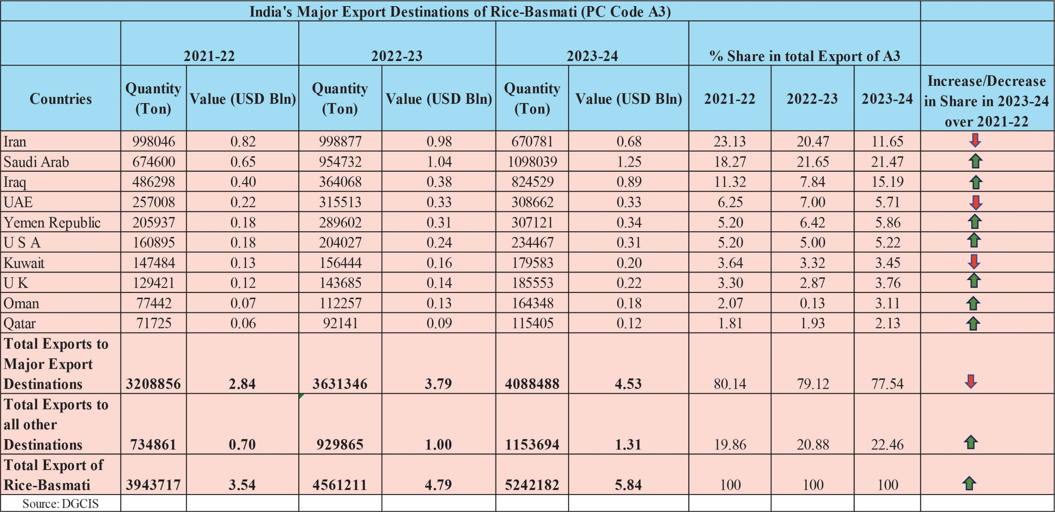
India’s Major Export Destinations
27

Slide 28
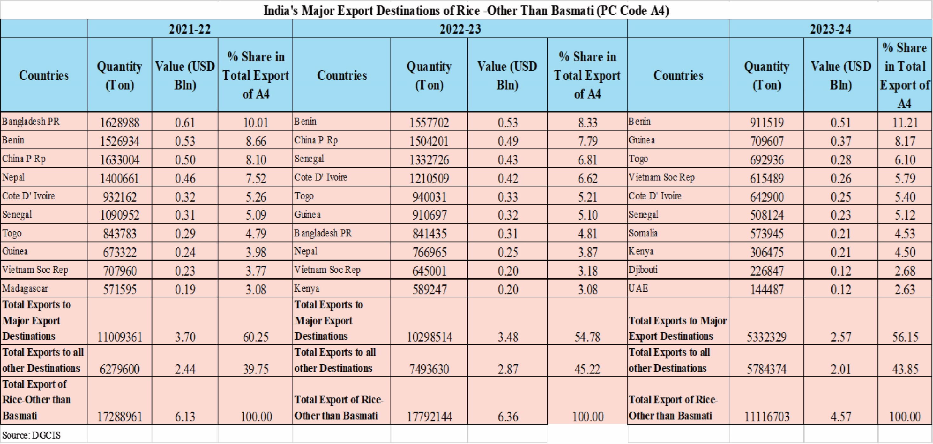
India’s Major Export Destinations
28

Slide 29
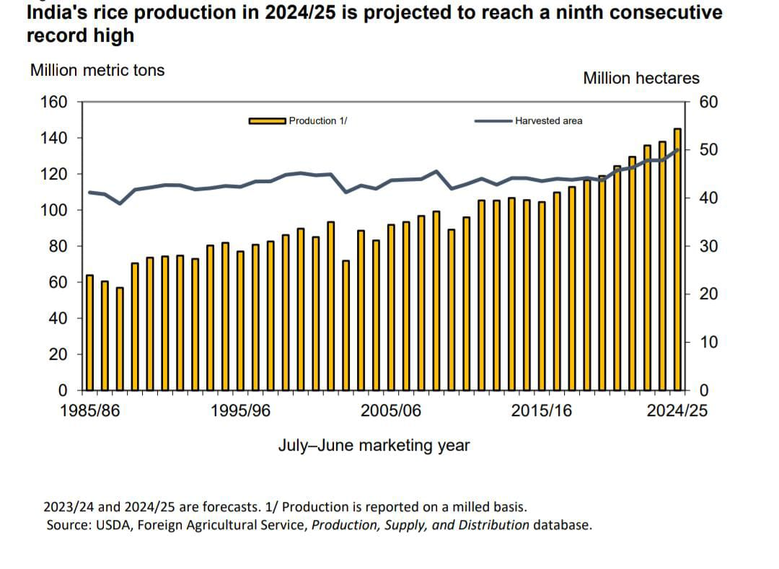
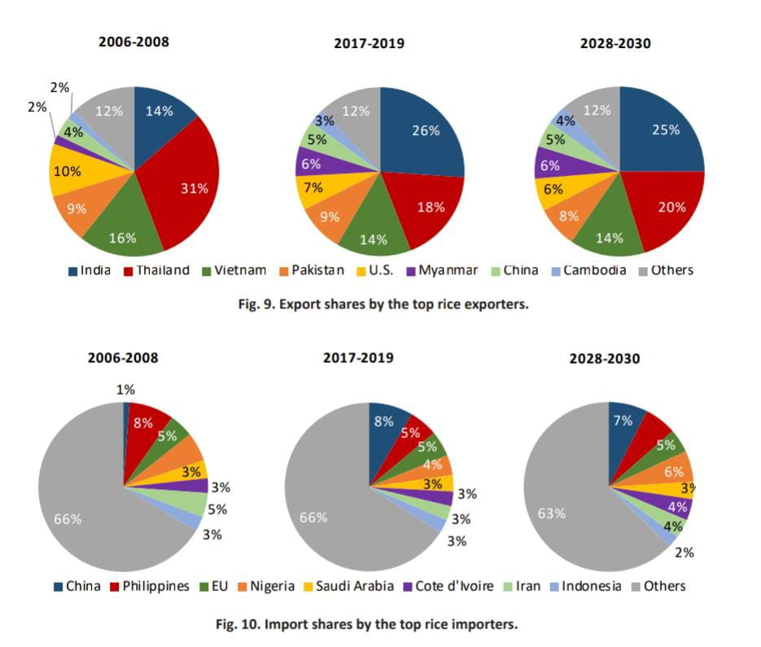
India's Rice Production and
Export Forecast for 2024/25
Projected Global Rice Market Trends:
Export and Import Shares (2028-2030)
29

Slide 30
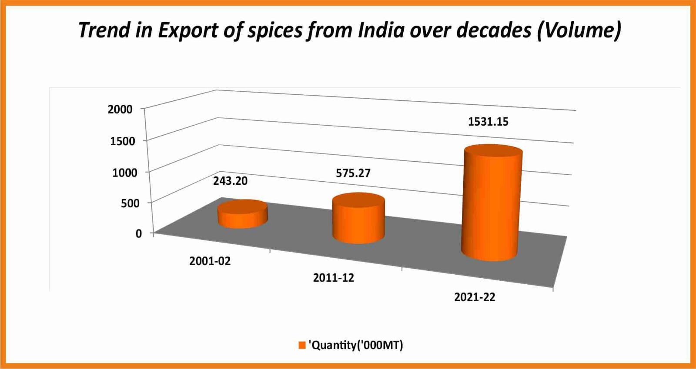
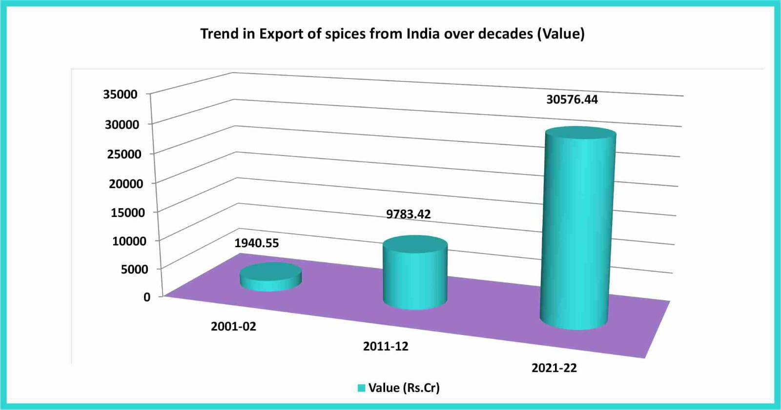
Trends in Export of Spices from India over Decades ( Values / Qty )
30

Slide 31


